Slide 1
ANLY 5332
Department of Information Systems and Analytics
McCoy College of Business Administration
Texas State University
Network Optimization

Slide 2
Outline
Minimum-Cost Flow Problem (Chapter 6.1)
Maximum Flow Problem (Chapter 6.2 - 6.3)
Shortest Path Problem (Chapter 6.4)
Minimum Spanning Tree Problem (Chapter 6S)
Network Modifications (not in the textbook)
Network Optimization Cases (Chapter 6)
Further Cases

Slide 3
Outline
Minimum-Cost Flow Problem (Chapter 6.1)
Maximum Flow Problem (Chapter 6.2 - 6.3)
Shortest Path Problem (Chapter 6.4)
Minimum Spanning Tree Problem (Chapter 6S)
Network Modifications (not in the textbook)
Network Optimization Cases (Chapter 6)
Further Cases

Slide 4
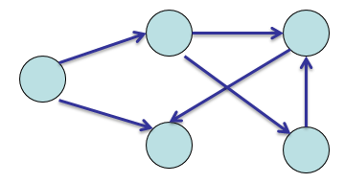
Minimum-Cost Flow Problem
Network: A set of arcs and nodes
  Arcs can be directed or undirected
  Many practical problems have network representation
    Assignment problems
    Transportation problems
    Transshipment problems
    Project management

Slide 5
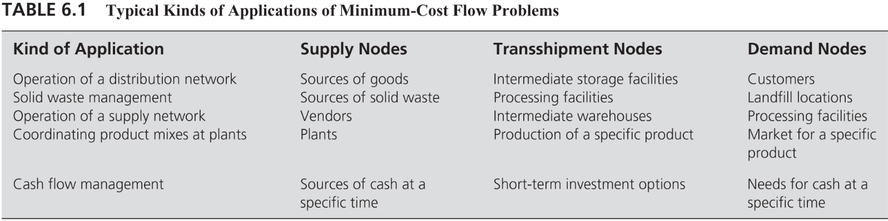
Minimum-Cost Flow Problem
Introduction: In a min-cost flow problem
  There is a set of supply points, each such point has a supply
  There is a set of demand points, each such point has a demand
  There is a set of transshipment points, each such point has no supply & no demand
  There are a set of arcs connecting various points
    Each arc has a unit cost and might have capacity
  Problem Description: There are supply nodes, demand nodes, and transshipments nodes and there are arcs. Determine the cost-minimum flows on the arcs so that the supply meets the demand
  Using a case, we will discuss:
    Algebraic modeling (not in the textbook)
    Spreadsheet modeling (Chapter 6.1)

Slide 6
Minimum-Cost Flow Problem
Case: The Distribution Unlimited Co. Problem
  The Distribution Unlimited Co. has two factories producing a product that needs to be shipped to two warehouses
    Factory 1 produces 80 units.
    Factory 2 produces 70 units.
    Warehouse 1 needs 60 units.
    Warehouse 2 needs 90 units.
  There are rail links directly
    From Factory 1 to Warehouse 1 and
    From Factory 2 to Warehouse 2.
  Independent truckers are available to ship up to 50 units from each factory to the distribution center, and then 50 units from the distribution center to each warehouse.

Slide 7
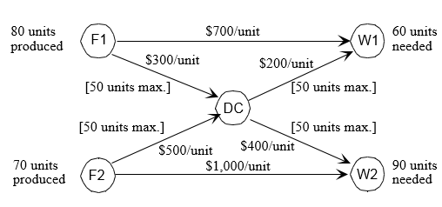
Minimum-Cost Flow Problem
Case: The Distribution Unlimited Co. Problem
  The cost and capacity of each link:
  Question: How many units (truckloads) should be shipped along each shipping lane so that the demands are met at the cost-minimum way?

Slide 8
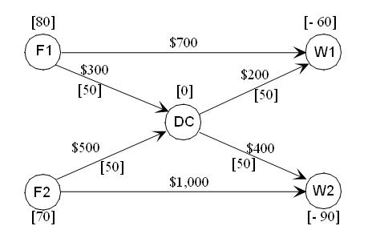
Minimum-Cost Flow Problem
Case: The Distribution Unlimited Co. Problem
  A network representation
  Determine the flow on each arc to minimize total costs while shipping the demand?
Positive value implies supply node
Negative value implies demand node
0 value implies transshipment node
Arc cost
[Arc capacity]

Slide 9
Minimum-Cost Flow Problem
Assumptions of Min-Cost Flow Problem:
    At least one of the nodes is a supply node.
    At least one of the other nodes is a demand node.
    All the remaining nodes are transshipment nodes.
    Flow through an arc is only allowed in the direction indicated by the arrowhead, where the maximum amount of flow is given by the capacity of that arc. (If flow can occur in both directions, this would be represented by a pair of arcs pointing in opposite directions.)
    The network has enough arcs with sufficient capacity to enable all the flow generated at the supply nodes to reach all the demand nodes.
    The cost of the flow through each arc is proportional to the amount of that flow, where the cost per unit flow is known.
    The objective is to minimize the total cost of sending the available supply through the network to satisfy the given demand. (An alternative objective is to maximize the total profit from doing this.)
    Later we will discuss how to modify the network representation when some of these assumptions do not hold true.

Slide 10
Minimum-Cost Flow Problem
Algebraic Model for Min-Cost Flow Problem: We can mathematically formulate a linear programming model for the min-cost flow problem
  Decision variables: Flow on each arc
    Number of decision variables = Number of arcs
    X(i,j): the flow on arc (i,j)
  The model template for min-cost flow problem:
  Minimize Total Cost
  Subject to Flow-Balance Constraints
  Arc-Capacity Constraints
  Non-negativity Constraints
One for each node!
One for each capacitated arc
For each arc

Slide 11
Minimum-Cost Flow Problem
Algebraic Model for Min-Cost Flow Problem:
  Objective and Objective Function: Minimize the total cost. Total cost is the sum of the costs on the arcs. Cost on an arc is unit cost of the arc times the flow on the arc
  Minimize 700X(F1,W1) + 300X(F1,DC) + 200X(DC,W1)
  + 400X(DC,W2) + 500X(F2,DC) + 1,000X(F2,W2)
  Constraints: Two sets of main constraints plus non-negativity constraints
    Arc-capacity constraints: One for each arc (if the arc has a capacity)
                X(i,j) <= Capacity(i,j)
    X(F1,DC)<=50
    X(F2,DC)<=50
    X(DC,W1)<=50
    X(DC,W2)<=50
No need for an arc capacity constraint for arcs with infinite capacity
→ (F1,W1) and (F2,W2)

Slide 12
Minimum-Cost Flow Problem
Algebraic Model for Min-Cost Flow Problem:
  Constraints: Two sets of main constraints plus non-negativity constraints
    Flow-balance constraints: One for each node
      If What is going out>What is coming in → Supply Node (node value is positive)
      If What is going out<What is coming in → Demand Node (node value is negative)
      If What is going out=What is coming in → Transshipment Node (node value is zero)
  What is going out – What is coming in = Node Value
Net Flow
Supply/Demand

Slide 13
Minimum-Cost Flow Problem
Algebraic Model for Min-Cost Flow Problem:
  Constraints: Two sets of main constraints plus non-negativity constraints
    Flow-balance constraints: One for each node
What is going out – What is coming in = Node Value
For node F1:
  What is going out: X(F1,DC) + X(F1,W1)
  What is coming in: Nothing
  Node value: 80
For node DC:
  What is going out: X(DC,W1) + X(DC,W2)
  What is coming in: X(F1, DC) + X(F2, DC)
  Node value: 0
For node F2:
  What is going out: X(F2,DC) + X(F2,W2)
  What is coming in: Nothing
  Node value: 70
X(F1,DC) + X(F1,W1) = 80
  [X(DC,W1) + X(DC,W2)] - [X(F1,DC) + X(F2,DC) ]=0
X(F2,DC) + X(F2,W2) = 70
For node W1:
  What is going out: Nothing
  What is coming in: X(F1,W1)+X(DC,W1)
  Node value: -60
For node W2:
  What is going out: Nothing
  What is coming in: X(F2,W2)+X(DC,W2)
  Node value: -90
-[X(F1,W1) + X(DC,W1)] = -60
-[X(F2,W2) + X(DC,W2)]= -90

Slide 14
Minimum-Cost Flow Problem
Case: The Distribution Unlimited Co. Problem
  Algebraic Model:
Minimize 700X(F1,W1) + 300X(F1,DC) + 200X(DC,W1) +400X(DC,W2) + 500X(F2,DC) + 1000X(F2,W2)
Subject to X(F1,DC) + X(F1,W1) = 80
X(F2,DC) + X(F2,W2) = 70
[X(DC,W1) + X(DC,W2)] - [X(F1,DC) + X(F2,DC) ]=0
-[X(F1,W1) + X(DC,W1)] = -60
-[X(F2,W2) + X(DC,W2)]= -90
    X(F1,DC)<=50
    X(F2,DC)<=50
    X(DC,W1)<=50
    X(DC,W2)<=50
    X(i,j)>=0 for all arcs (i,j)

Slide 15
Minimum-Cost Flow Problem
Case: The Distribution Unlimited Co. Problem
  Spreadsheet Model:
The SUMIF formula can be used to simplify the node flow constraints.
=SUMIF(Range A, x, Range B)
For each quantity in (Range A) that equals x, SUMIF sums the corresponding entries in (Range B).
The net flow (flow out – flow in) from node x is then
=SUMIF(“From labels”, x, “Flow”) – SUMIF(“To labels”, x, “Flow”)

Slide 16
Minimum-Cost Flow Problem
Case: The Distribution Unlimited Co. Problem
  Optimal Solution: Minimum total cost is $117,000

Slide 17
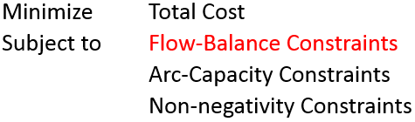
Minimum-Cost Flow Problem
Properties:
  The Feasible Solutions Property
    Under the previous assumptions, a minimum-cost flow problem will have feasible solutions if and only if the sum of the supplies from its supply nodes equals the sum of the demands at its demand nodes.
  The Integer Solutions Property
    As long as all the supplies, demands, and arc capacities have integer values, any minimum-cost flow problem with feasible solutions is guaranteed to have an optimal solution with integer values for all its flow quantities
Assumptions:
  Total supply = total demand
  Arcs are directed
If we deviate from this formulation, the properties will not hold. For instance, if a constraint, which is not a flow balance constraint or arc capacity constraint is added, then we deviate from the min-cost flow model
If total supply < total demand, the problem is practically infeasible as you cannot supply the demand
If total supply > total demand, network can be modified with a dummy demand node, of which demand is equal to excess supply
If arcs are undirected (i.e., flow is possible on both directions), we will replace is with two arcs: one in each direction

Slide 18
Outline
Minimum-Cost Flow Problem (Chapter 6.1)
Maximum Flow Problem (Chapter 6.2 - 6.3)
Shortest Path Problem (Chapter 6.4)
Minimum Spanning Tree Problem (Chapter 6S)
Network Modifications (not in the textbook)
Network Optimization Cases (Chapter 6)
Further Cases

Slide 19
Maximum Flow Problem
Introduction: In a maximum flow problem
  There is a set of source nodes, each such node can supply
  There is a set of sink nodes, each such node can receive
  There is a set of transshipment nodes, each such node is an intermediate point
  Each arc has a capacity, and cost is not of concern
  Problem Description: There are sources, sinks, and intermediate nodes. Determine the maximum amount that can be sent from sources to the sinks on the network.
  Using a case, we will discuss:
    Algebraic modeling (not in the textbook)
    Spreadsheet modeling (Chapter 6.2-6.3)
Applications:
Maximize the flow through a distribution network
Maximize the flow through a company’s supply network from its vendors to its processing facilities.
Maximize the flow of oil through a system of pipelines.
Maximize the flow of water through a system of aqueducts.
Maximize the flow of vehicles through a transportation network.

Slide 20
Maximum Flow Problem
Case: The BMZ Co. Problem
  The BMZ Company is a European manufacturer of luxury automobiles. Its exports to the United States are particularly important.
    BMZ cars are becoming especially popular in California, so it is particularly important to keep the Los Angeles center well supplied with replacement parts for repairing these cars.
    BMZ needs to execute a plan quickly for shipping as much as possible from the main factory in Stuttgart, Germany to the distribution center in Los Angeles over the next month.
    The limiting factor on how much can be shipped is the limited capacity of the company’s distribution network.

Slide 21
Maximum Flow Problem
Case: The BMZ Co. Problem
  A network representation
    Arcs have capacities
    Cost is not of concern
  Question: How many units should be sent through each shipping lane to maximize the total units flowing from Stuttgart to Los Angeles?
[Arc capacity]
Source node
Sink node
Transshipment (intermediate) nodes

Slide 22
Maximum Flow Problem
Assumptions of Max Flow Problem:
    All flow through the network originates at one node, called the source, and terminates at one other node, called the sink. (The source and sink in the BMZ problem are the factory in Stutgart and the distribution center in LA, respectively.)
      Later, we will discuss multi-source and multi-sink problems
    All the remaining nodes are transshipment nodes.
    Flow through an arc is only allowed in the direction indicated by the arrowhead, where the maximum amount of flow is given by the capacity of that arc. At the source, all arcs point away from the node. At the sink, all arcs point into the node.
    The objective is to maximize the total amount of flow from the source to the sink. This amount is measured in either of two equivalent ways, namely, either the amount leaving the source or the amount entering the sink.
    Later we will discuss how to modify the network representation when some of these assumptions do not hold true.

Slide 23
Maximum Flow Problem
Algebraic Model for Maximum Flow Problem: We can mathematically formulate a linear programming model for the max flow problem
  Decision variables: Flow on each arc
    Number of decision variables = Number of arcs
    F(i,j): the flow on arc (i,j)
  The model template for max-flow problem:
  Maximize Flow out of Sources
  (or Flow into sinks)
  Subject to Flow-Balance Constraints
  Arc-Capacity Constraints
  Non-negativity Constraints
One for each transshipment/intermediate node!
→No flow balance for sources
→No Flow balance for sinks
One for each capacitated arc
For each arc

Slide 24
Maximum Flow Problem
Algebraic Model for Maximum Flow Problem:
  Objective and Objective Function: Maximize the flow out of the sources or maximize the flow coming into the sinks.
  Maximize F(ST,RO)+F(ST,BO)+F(ST,LI)
  OR
  Maximize F(NY,LA)+F(NO,LA)
  Constraints: Two sets of main constraints plus non-negativity constraints
    Arc-capacity constraints: One for each arc (if the arc has a capacity)
                X(i,j) <= Capacity(i,j)
    F(ST,RO)<=50 F(ST,BO)<=70 F(ST,LI)<=40
    F(RO,NY)<=60 F(BO,NY)<=40 F(BO,NO)<=50
    F(LI,NO)<=30 F(NY,LA)<=80 F(NO,LA)<=70
No need for an arc capacity constraint for arcs with infinite capacity

Slide 25
Maximum Flow Problem
Algebraic Model for Maximum Flow Problem:
  Constraints: Two sets of main constraints plus non-negativity constraints
    Flow-balance constraints: One for each intermediate/transshipment node
      No flow balance constraints for source nodes
      No flow balance constraints for the sink nodes
      No flow balance for the sources and sinks because:
        We do not know how much is going out of the sources before solving the model
        We do not know how much is coming to the sinks before solving the model
  What is going out – What is coming in = Node Value
Net Flow
0 for
intermediate/transshipment
nodes

Slide 26
Maximum Flow Problem
Case: The BMZ Co. Problem
  Algebraic Model:
No flow balance constraints for the sinks and sources
A Flow balance constraint for each intermediate node
Arc capacity constraint for each capacitated arc
Non-negativity

Slide 27
Maximum Flow Problem
Case: The BMZ Co. Problem
  Spreadsheet Model:
We can use the SUMIF function for the flow balance constraints:
=SUMIF(“From labels”, x, “Flow”) – SUMIF(“To labels”, x, “Flow”)

Slide 28
Outline
Minimum-Cost Flow Problem (Chapter 6.1)
Maximum Flow Problem (Chapter 6.2 - 6.3)
Shortest Path Problem (Chapter 6.4)
Minimum Spanning Tree Problem (Chapter 6S)
Network Modifications (not in the textbook)
Network Optimization Cases (Chapter 6)
Further Cases

Slide 29
Shortest Path Problem
Introduction: In a shortest path problem
  There is an origin node
  There is a destination node
  Each arc has a distance (might be cost, time, risk, etc. depending on the application)
  Problem Description: Find the shortest path from the origin to the destination on the network.
    Path: A collection of arcs that lead from the origin node to the destination node
  Using a case, we will discuss:
    Algebraic modeling (not in the textbook)
    Spreadsheet modeling (Chapter 6.4)
Applications:
Routing (gps)
Maintenance (see Sarah’s car maintenance problem, page 212-214)
Project Management (see Quick Company problem, page 214-218

Slide 30
Shortest Path Problem
Case: Littletown Fire Department Problem
  Littletown is a small town in a rural area
    Its fire department serves a relatively large geographical area that includes many farming communities.
    Since there are numerous roads throughout the area, many possible routes may be available for traveling to any given farming community.
  Question: Which route from the fire station to a certain farming community minimizes the total number of miles?

Slide 31
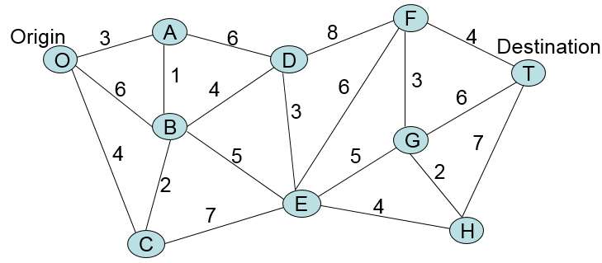
Shortest Path Problem
Case: Littletown Fire Department Problem
  A network representation
  A path is a collection of arcs lead from origin to destination
    O→B→D→F→T is one path with a total distance of 22 miles
    O→C→B→E→G→H→T is another path with total distance of 25 miles
Find the path with the minimum total distance.

Slide 32
Minimum-Cost Flow Problem
Assumptions of Shortest Path Problem:
    You need to choose a path through the network that starts at a certain node, called the origin, and ends at another certain node, called the destination.
    The lines connecting certain pairs of nodes commonly are links (which allow travel in either direction), although arcs (which only permit travel in one direction) also are allowed.
    Associated with each link (or arc) is a nonnegative number called its length. (Be aware that the drawing of each link in the network typically makes no effort to show its true length other than giving the correct number next to the link.)
    The objective is to find the shortest path (the path with the minimum total length) from the origin to the destination.
Relation to minimum-cost flow problem:
  Consider a min-cost flow problem such that
    There is one supply node with a supply of 1 unit (so its node value is 1)
    There is one demand node with a demand of 1 unit (so its node value is -1)
    Every other node is a transshipment node (so their node values are 0)
    How would you send the one unit of flow from the supply node to the demand node?

Slide 33
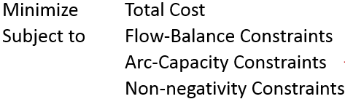
Shortest Path Problem
Algebraic Model for Shortest Path Problem: We can mathematically formulate a shortest path problem as a min-cost flow problem
  Make the origin node a supply node of 1 unit (so its node value is 1)
  Make the destination node a demand node of 1 unit (so its node value is -1)
  Make all other nodes a transshipment node (so their node values are 0)
  Make all the arcs directed by replacing an undirected are with two arcs:
    One in each direction, with the same distance (which are the arc costs)
    No arc capacities
  Then formulate and solve a min-cost flow problem for the resulting network
    Due to integer solutions property of min-cost flow problem, the flows will be 1’s or 0’s at the optimum solution of the resulting min-cost flow problem
    Following the arcs with flows of 1 unit, we get the shortest path

Slide 34
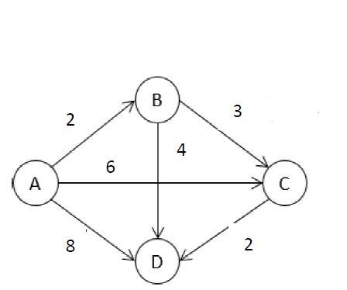
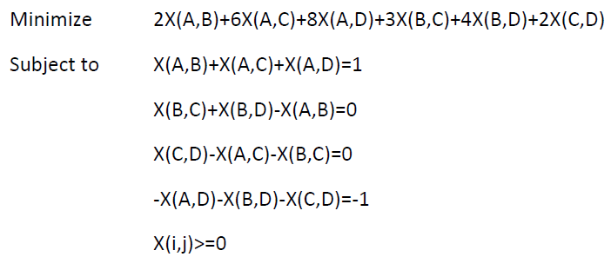
Shortest Path Problem
Algebraic Model for Shortest Path Problem:
  A small demonstration: Find the shortest path from A to D
[0]
[1]
[0]
[-1]

Slide 35
Shortest Path Problem
Case: The Littletown Fire Department Problem
  Spreadsheet Model: As a min-cost flow problem
You do not need to replace each undirected arc with two directed arcs
For instance, we know that if you go from Fire St. to A, we will not go back from A to Fire St. So there is no need for A→Fire St.
It is ok if you replace each undirected arc with two directed arcs, it would just increase the number of arcs in the model, it will not affect the optimal solution (i.e., the shortest path)
Shortest Path is:
Fire St. →A→B→E→F→Farm Com.
(follow the 1’s in the optimum solution)

Slide 36
Outline
Minimum-Cost Flow Problem (Chapter 6.1)
Maximum Flow Problem (Chapter 6.2 - 6.3)
Shortest Path Problem (Chapter 6.4)
Minimum Spanning Tree Problem (Chapter 6S)
Network Modifications (not in the textbook)
Network Optimization Cases (Chapter 6)
Further Cases

Slide 37
Minimum Spanning Tree Problem
Introduction: In a minimum spanning tree problem
  You are given the nodes of a network but not the links. Instead, you are given the potential links and the positive cost (or a similar measure) for each if it is inserted into the network.
  Problem Description: You wish to design the network by inserting enough links to satisfy the requirement that there be a path between every pair of nodes.
  The objective is to satisfy this requirement in a way that minimizes the total cost.
    Applications:
      Design of telecommunication networks (computer networks, lease-line telephone networks, cable television networks, etc.)
      Design of a lightly-used transportation network to minimize the total cost of providing the links (rail lines, roads, etc.)
      Design of a network of high-voltage electrical power transmission lines.
      Design of a network of wiring on electrical equipment (e.g., a digital computer system) to minimize the total length of the wire.
      Design of a network of pipelines to connect a number of locations.

Slide 38
Minimum Spanning Tree Problem
Case Description: Modern Corporation has decided to have a state-of-the-art fiber-optic network installed to provide high-speed communication (data, voice, and video) between its major centers.
  Any pair of centers do not need to have a cable directly connecting them in order to take advantage of the technology. All that is necessary is to have a series of cables that connect the centers.
  Question: Which cables should be installed to provide high-speed communications between every pair of centers?
  Solution Algorithm:
    Select the cheapest link.
    Select the cheapest potential link between a connected node and an unconnected node.
    Repeat until all nodes are connected.
Note: Ties may be broken arbitrarily! There may or may not be multiple optimal solutions.

Slide 39
Minimum Spanning Tree Problem
Case Solution: A spanning tree
2
7
5
2
5
4
7
1
4
3
1
4

Slide 40
Minimum Spanning Tree Problem
Case Solution: Another spanning tree
2
7
5
2
5
4
7
1
4
3
1
4

Slide 41
Minimum Spanning Tree Problem
Case Solution:
2
7
5
2
5
4
7
1
4
3
1
4

Slide 42
Outline
Minimum-Cost Flow Problem (Chapter 6.1)
Maximum Flow Problem (Chapter 6.2 - 6.3)
Shortest Path Problem (Chapter 6.4)
Minimum Spanning Tree Problem (Chapter 6S)
Network Modifications (not in the textbook)
Network Optimization Cases (Chapter 6)
Further Cases

Slide 43
Network Modifications
The network optimization models have specific algebraic structures that help with developing efficient methods to solve them
  If deviated from the structure, the methods will not work because some of the properties will not hold
  Therefore, it is important to maintain the algebraic model’s structure
Assumptions we have:
  Arcs are directed
  Total supply = total demand
  No node capacities
If these assumptions are not satisfied, we can modify the network representation and algebraically model the problem on the modified network

Slide 44

Network Modifications
Undirected arcs: When there is an undirected arc in a min-cost, max flow, or shortest path problem
  Replace the undirected arc with two arcs, one in each direction
  Cost of each directed arc will be the cost of the undirected arc
  Capacity of each directed arc will be the capacity of the undirected arc
  This will work because, at the optimal solution, we will not be sending flows in both direction because it is additional cost for sending flow from a point back to that point (instead, we can keep the flow at the original place)

Slide 45
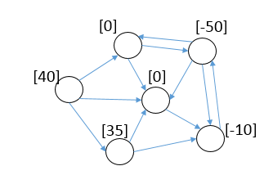
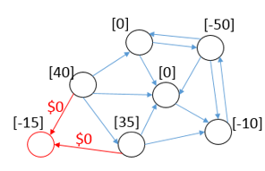

Network Modifications
Total Supply vs. Total Demand: In min-cost flow problems, we assumed that total supply is equal to total demand
  If total supply is less than total demand, the problem is infeasible
  If total supply is more than total demand, the problem is actually not infeasible
    But, we cannot have flow balance constraints as = constraints
  If total supply is more than total demand
    Create a dummy demand node of which demand is equal to excess supply
    Draw an arc from each supply node to the dummy demand node
    The arcs will have 0 cost and no capacity
We can formulate a min-cost flow problem on the modified network

Slide 46
Network Modifications
Node Capacity: Sometimes, the problem might have capacity on the node
  The flow through the node cannot exceed the capacity
  We can formulate a constraint for this: What’s_coming_in_to_node <= Node_capacity
  But this is not a flow balance constraints and it is not an arc capacity constraint when there are multiples arcs coming in
    For instance, we would have X(A,B)+X(C,B)<=50 if node B has a capacity of 50 and two arcs coming into node B from nodes A and C
  If we have a node with capacity
    Replace the node with two nodes: one representing entrance to the node and one representing exit from the node
      All of the arcs coming into the original node are now coming into the entrance node
      All of the arcs going out of the original node are now going out of the exist node
    Connect the entrance and exit nodes with an arc from entrance to the exit
    The capacity of the node is the capacity of the arc connecting the entrance and exist nodes
    The node value of the original node will either be in the entrance or exit node depending on whether the original node is supply or demand node

Slide 47
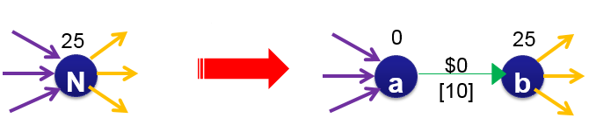
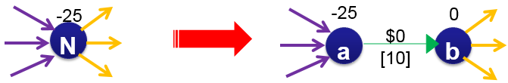
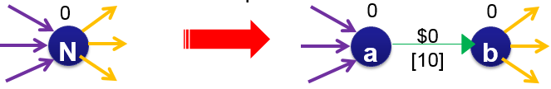
Network Modifications
Node Capacity:
  Demonstration: Suppose node N in the network has a capacity of 10 units
    If node N is a supply node with node value 25, assign supply to the exit
    If node N is a demand node with node value -25, assign demand to the entrance
    If node N is a transshipment node with node value 0, both entrance and exit nodes are transshipment nodes too

Slide 48
Network Modifications
Alternative Origins and/or Destinations: In a shortest path problem, if there are nodes, each of which can be a potential origin, or there are nodes, each of which can be a potential destination, we can modify the network and have a single origin and single destination
  This will avoid solving a shortest path problem for each possible origin-destination pair
  When there are multiple possible origins:
    Create a dummy origin node
    Draw and arc from the dummy origin to each potential origin
    The arcs connecting dummy origin to the potential origins will have 0 cost (0 distance)
  When there are multiple possible destinations:
    Create a dummy destination node
    Draw an arc from each possible destination node to the dummy destination node
    The arcs connecting the possible destination nodes to the dummy destination node will have 0 cost (0 distance)

Slide 49
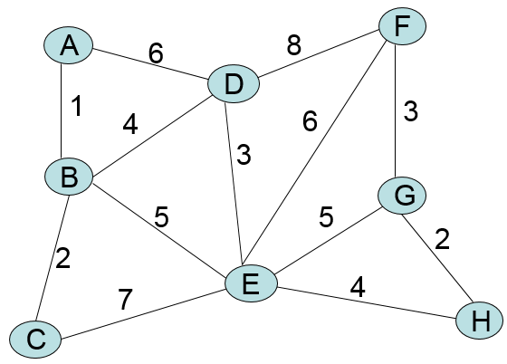
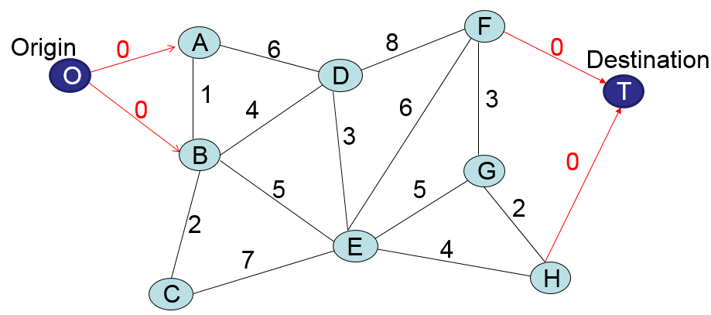
Network Modifications
Alternative Origins and/or Destinations:
  Demonstration: Suppose you want to find a shortest path from start to end, your start can be either node A or node B and your end-point can be either F or H
  After the modification, we can solve a single shortest path problem from O to T, and find where to start and where to end (the ones that are on the path)!

Slide 50
Outline
Minimum-Cost Flow Problem (Chapter 6.1)
Maximum Flow Problem (Chapter 6.2 - 6.3)
Shortest Path Problem (Chapter 6.4)
Minimum Spanning Tree Problem (Chapter 6S)
Network Modifications (not in the textbook)
Network Optimization Cases (Chapter 6)
Further Cases

Slide 51
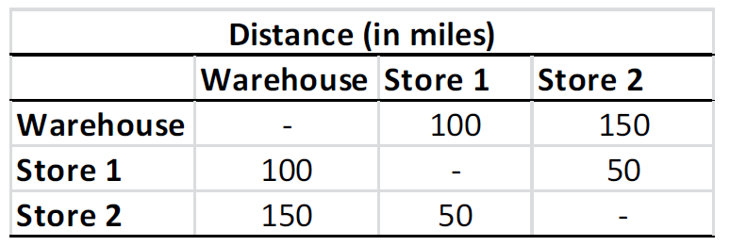
A Minimum-Cost Flow Problem
Case: Carrier Selection (not in the textbook):
  Suppose that you are the distribution manager of a warehouse. You need to determine how to ship 100 units of a specific product to two retailer stores. Each retailer store requires 50 units of the product. There are three carriers that you can use to ship the product from the warehouse to the retailer stores and there is another carrier that can ship the product between the retailer stores. The specifications of the carriers are as follows:
    Carrier 1: It charges $15 to pick up one unit of the product from the warehouse. It charges $0.25 to ship one unit of the product one mile. It can ship at most 40 units of the product. It can only ship to retailer store 1 from the warehouse.
    Carrier 2: It charges $8 to pick up one unit of the product from the warehouse. It charges $0.30 to ship one unit of the product one mile. It can ship at most 30 units of the product. It can ship to both retailer stores from the warehouse.
    Carrier 3: It charges $12 to pick up one unit of the product from the warehouse. It charges $0.20 to ship one unit of the product one mile. It can ship at most 50 units of the product. It can only ship to retailer store 2 from the warehouse.
    Carrier 4: It charges $10 to pick up one unit of the product from any retailer store. It charges $0.40 to ship one unit of the product one mile. It can ship as much as you want. It can only ship between the retailer stores.
The distances from the warehouse to each retailer store and between the retailer stores :

Slide 52
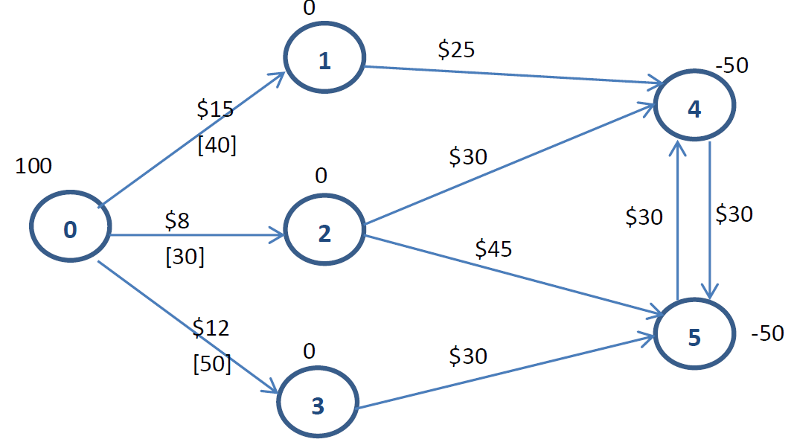
A Minimum-Cost Flow Problem
Case: Carrier Selection (not in the textbook):
  A network representation:
Nodes: 1 node for the warehouse (node 0), 3 nodes for carriers 1, 2, and 3 (node 1, node 2, and node 3, respectively), and 2 nodes for the retailers (node 4 and node 5). Node 0 is the supply node with supply of 100, i.e., node value 100. Nodes 4 and 5 are demand nodes with demand of 50, i.e., node values are -50 for each. Nodes 1, 2, and 3 are transshipment nodes, they have node values of 0 as they needed to ship whatever they pick.
The arcs from nodes 1, 2, and 3 to nodes 4 and/or 5 represent the items shipped by carriers from the warehouse to the retailer stores. They do not have capacities as we have already enforced the capacities of the carriers. They have the unit transportation cost calculated by using the distance from the warehouse to the retailer stores and the charge of each carrier for one unit for one mile.
Finally, the arcs between nodes 4 and 5 represent the carrier 4 as it can ship between the retailer stores. The costs on these arcs include the pick-up cost by carrier 4 and the unit transportation cost calculated considering the distance between the retailer stores and carrier 4’s charge per unit per mile. Carrier 4 does not have capacity.
Arcs: Arcs from node 0 to node 1, node 2, and node 3 represent the number of items picked by carriers 1, 2, and 3 from the warehouse. Therefore, those arcs have the pickup cost specific to each carrier and the capacity representing how much each carrier can ship.

Slide 53
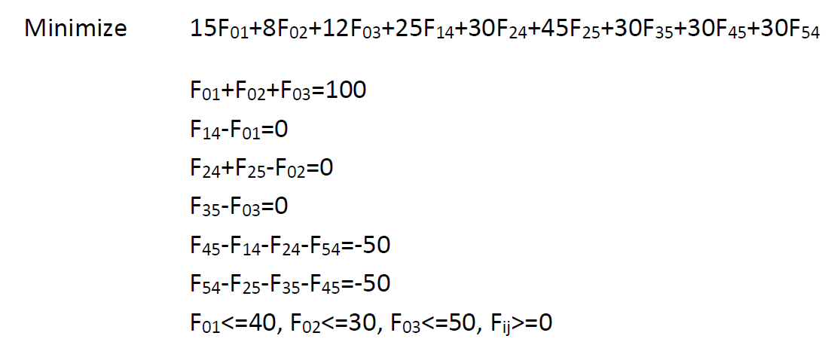
A Minimum-Cost Flow Problem
Case: Carrier Selection (not in the textbook):
  Algebraic model:
    Let F(i,j) denote the flow on arc (i,j).

Slide 54
Multi-Source Multi-Sink Max Flow Problem
We discussed maximum flow problems with one source node and one sink node. It is possible that there are multiple sources and/or multiple sinks
  One approach is to modify the network so that we have single source & single sink
    Introduce a dummy source node, include arcs from the dummy source node to each original source node such that those arcs have unlimited capacity (they are uncapacitated)
    Introduce a dummy sink node, include arcs from each original sink node to the dummy sink node such that those arcs have unlimited capacity (they are uncapacitated)
    Maximize the flow from the dummy source node to the dummy sink node!
  The other approach is to formulate with multiple sources and multiple sinks
    Maximize the total flow out of all sources (or maximize the total flow into all sinks)
    No flow balance for the sources and no flow balance for the sinks
    Flow balance for non-source non-sink nodes (i.e., intermediate/transshipment nodes)
    And arc capacity and non-negativity constraints

Slide 55
Multi-Source Multi-Sink Max Flow Problem
Case: Extended BMZ Co. Problem:
  BMZ has a second, smaller factory in Berlin.
  The distribution center in Seattle has the capability of supplying parts to the customers of the distribution center in Los Angeles when shortages occur at the latter center.
  Question: How many units should be sent through each shipping lane to maximize the total units flowing from Stuttgart and Berlin to Los Angeles and Seattle?

Slide 56
Multi-Source Multi-Sink Max Flow Problem
Case: Extended BMZ Co. Problem:
  Spreadsheet model:

Slide 57
Maintenance Planning as a Shortest Path Problem
Case: Sarah’s Car Purchase Problem (Chapter 6.4):
  Sarah has just graduated from high school. As a graduation present, her parents have given her a car fund of $21,000 to help purchase and maintain a three-year-old used car for college
  Since operating and maintenance costs go up rapidly as the car ages, Sarah may trade in her car on another three-year-old car one or more times during the next three summers if it will minimize her total net cost. (At the end of the four years of college, her parents will trade in the current used car on a new car for Sarah.)
  When should Sarah trade in her car (if at all) during the next three summers?
 | Operating and Maintenance Costs for Ownership Year |  |  |  |  | Trade-in Value at End of Ownership Year
Purchase Price | 1 | 2 | 3 | 4 |  | 1 | 2 | 3 | 4
$12,000 | $2,000 | $3,000 | $4,500 | $6,500 |  | $8,500 | $6,500 | $4,500 | $3,000

Slide 58
Maintenance Planning as a Shortest Path Problem
Case: Sarah’s Car Purchase Problem (Chapter 6.4):
  Network representation:
→ Arc length = Purchase Price + O/M Costs – Trade-In

Slide 59
Maintenance Planning as a Shortest Path Problem
Case: Sarah’s Car Purchase Problem (Chapter 6.4):
  Spreadsheet model:

Slide 60
Outline
Minimum-Cost Flow Problem (Chapter 6.1)
Maximum Flow Problem (Chapter 6.2 - 6.3)
Shortest Path Problem (Chapter 6.4)
Minimum Spanning Tree Problem (Chapter 6S)
Network Modifications (not in the textbook)
Network Optimization Cases (Chapter 6)
Further Cases

Slide 61
A Shortest Path Problem
Case: Quick Co. Product Development Scheduling Problem (Chapter 6.4):
  The Quick Company has learned that a competitor is planning to come out with a new kind of product with great sales potential.
    Quick has been working on a similar product that had been scheduled to come to market in 20 months. Quick’s management wishes to rush the product out to meet the competition.
    Each of four remaining phases can be conducted at a normal pace, at a priority pace, or at crash level to expedite completion. However, the normal pace has been ruled out as too slow for the last three phases.
    $30 million is available for all four phases.
  Question: At what pace should each of the phases be conducted?

Slide 62
A Shortest Path Problem
Case: Quick Co. Product Development Scheduling Problem (Chapter 6.4):
Level | Remaining Research | Development | Design of Mfg. System | Initiate Production and Distribution
Normal | 5 months | — | — | —
Priority | 4 months | 3 months | 5 months | 2 months
Crash | 2 months | 2 months | 3 months | 1 month
Level | Remaining Research | Development | Design of Mfg. System | Initiate Production and Distribution
Normal | $3 million | — | — | —
Priority | 6 million | $6 million | $9 million | $3 million
Crash | 9 million | 9 million | 12 million | 6 million
We can construct a network such that each node corresponds to a state, which includes the phase completed and remaining budget

Slide 63
A Shortest Path Problem
Case: Quick Co. Product Development Scheduling Problem (Chapter 6.4):
  A network representation:
State: (# of phases complete, remaining budget)

Slide 64
A Shortest Path Problem
Case: Quick Co. Product Development Scheduling Problem (Chapter 6.4):
  Spreadsheet model:
Phase | Level | Time | Cost
Remaining research | Crash | 2 months | $9 million
Development | Priority | 3 months | 6 million
Design of manufacturing system | Crash | 3 months | 12 million
Initiate production and distribution | Priority | 2 months | 3 million
Total |  | 10 months | $30 million

Slide 65
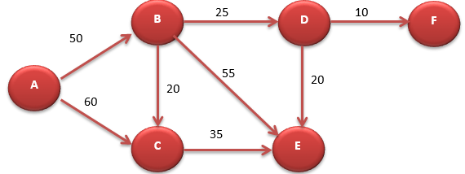
A Maximum Flow Problem
Case: Evacuation Planning (not in the textbook):
  Suppose that you are planning to come up with an evacuation plan in case of emergency. In particular, your goal is to send as many people as possible from facility A to safe facilities E and F. The network is depicted below. The numbers on the arcs represent the number of people that can travel on the arc per minute.
  Determine how to evacuate as many people as possible per minute from facility A to facilities E and F by finding how many people will use each link.

Slide 66
A Maximum Flow Problem
Case: Evacuation Planning (not in the textbook):
  The problem is a maximum flow problem with source being node A and sinks being nodes E and F.
    Let F(i,j) be the flow on arc (i,j)
Maximize F(A,B)+ F(A,C)
Subject to F(B,C)+F(B,E)+F(B,D)-F(A,B)=0
F(C,E)-F(A,C)-F(B,C)=0
F(D,F)+F(D,E)-F(B,D)=0
F(A,B)<=50, F(A,C)<=60, F(B,C)<=20, F(B,D)<=25 F(B,E)<=55,F(D,E)<=20, F(D,F)<=10, F(C,E)<=35
F(i,j)>=0

Slide 67
A Minimum-Cost Flow Problem
Case: Production and Distribution Planning (not in the textbook):
  Suppose that you are the production and distribution manager of a product which has 3 different sizes: 5lbs packets, 8lbs packets and 10lbs packets.
    Your company manufactures all different sizes of this product in the same manufacturing plant.
    Then, 5lb packets have to be shipped to Assembly Plant 1, 8lbs packets have to be shipped to Assembly Plant 2, and 10lbs packets have to be shipped to Assembly Plant 3 for their special boxing operations. The products with varying sizes are then shipped to the customers.
    The demand for 5lbs packets is 300, the demand for 8lbs packets is 450 and the demand for 10lbs packets is 250. However, if you desire, you can satisfy the demand for a specific size of the product by a larger size of the product (the customers would not say no when they get more).
    Question: Determine how many of each different size of this product to produce in your manufacturing plant and how to ship them to the customers so that you minimize the total costs.
Unit Shipping Costs:
Unit Shipping Costs:

Slide 68
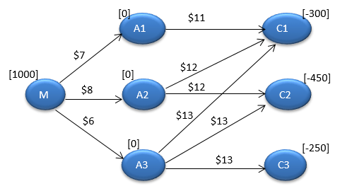
A Minimum-Cost Flow Problem
Case: Production and Distribution Planning (not in the textbook):
  A network representation:
Nodes: manufacturing plant (M), three assembly plants (A1,A2,A3) and 3 different types of customers (C1,C2,C3).
From M, we can send products to A1, A2, and A3 depending on their sizes. The flows on these arcs are the production quantities. For instance, the flow on arc (M,A1) would be the number of 5lbs packets we produce.
From assembly plants, we will ship to customers. Note that we can ship 5lbs packets as well as 8lbs and 10lbs packets to customer 1, and we can ship 8lbs as well as 10lbs packets to customers 2, and we can ship 10lbs packets to customer 3.

Slide 69
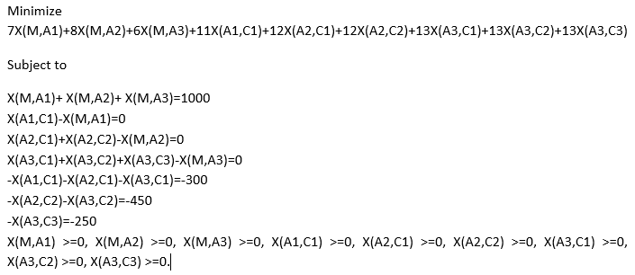
A Minimum-Cost Flow Problem
Case: Production and Distribution Planning (not in the textbook):
  Algebraic model:
    Let X(i,j) denote the flow on arc (i,j).

